Slide 1

Medical Pill Dispenser
ME 6705 Final Project
by Kushal Shah and Karthik Koundinya

Slide 2

Motivation
While patients are in recovery, they need someone to give them regular medications.
This always requires regular availability of care givers, which might not always be possible.
We wanted to automate this process for multiple patients and multiple medications and remove dependence on care givers ,
This is useful, especially in shared hospital rooms.

Slide 3

Sensors and Actors used
Sensors
Temperature sensor
Accelerometer
Keypad
Actors
Buzzer
LED
DC motor with encoder (x2)

Slide 4

System Thresholds and Objectives achieved
The system is successfully able to fetch the pill schedule from the web
The buzzer alerts different patients using different types of sounds
Accelerometer detects pill dispensing
Temperature sensor detects notifies if the medicine is not stored at correct temperature using an LED.
PID control implemented on the motors for dispensing pills
Keypad used for patients to enter their authentication code.
Dispensing mechanism works with negligible error.

Slide 5
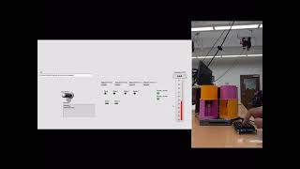

Slide 6
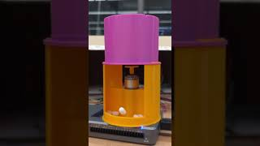
Continuous pill dispensing without error.

Slide 7
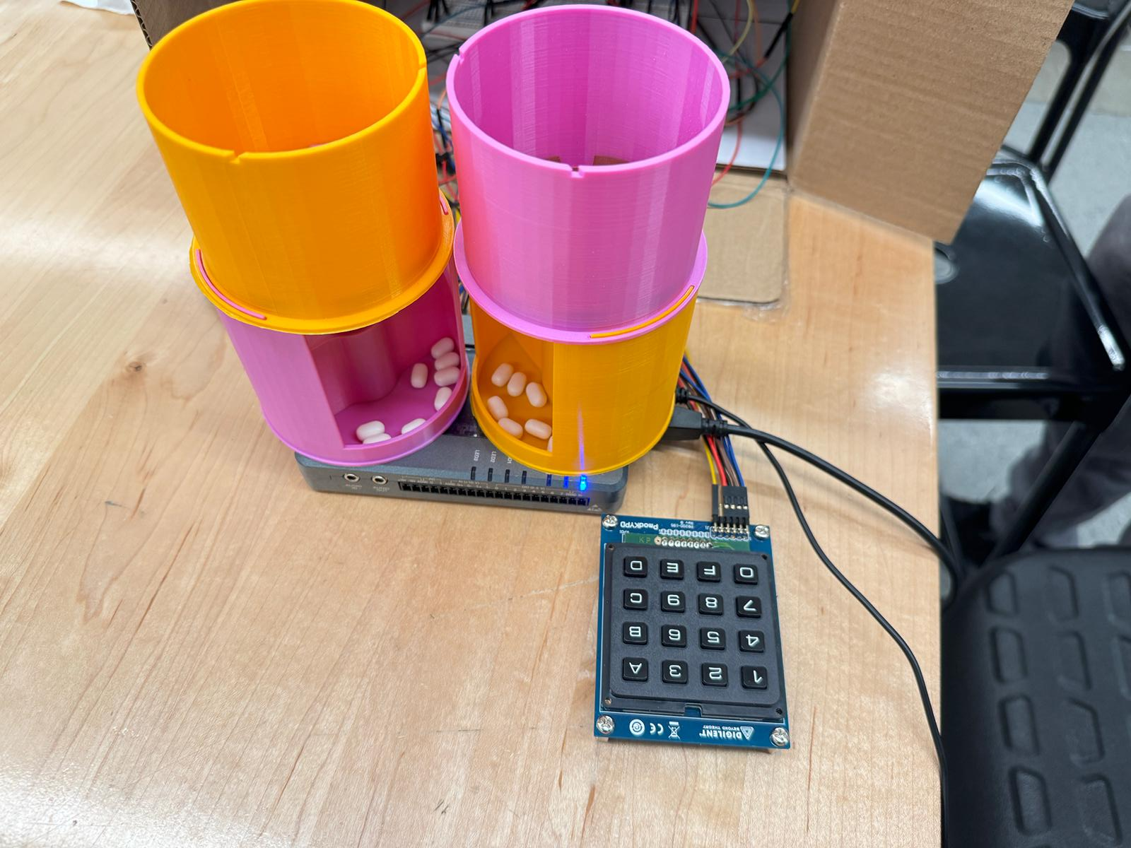
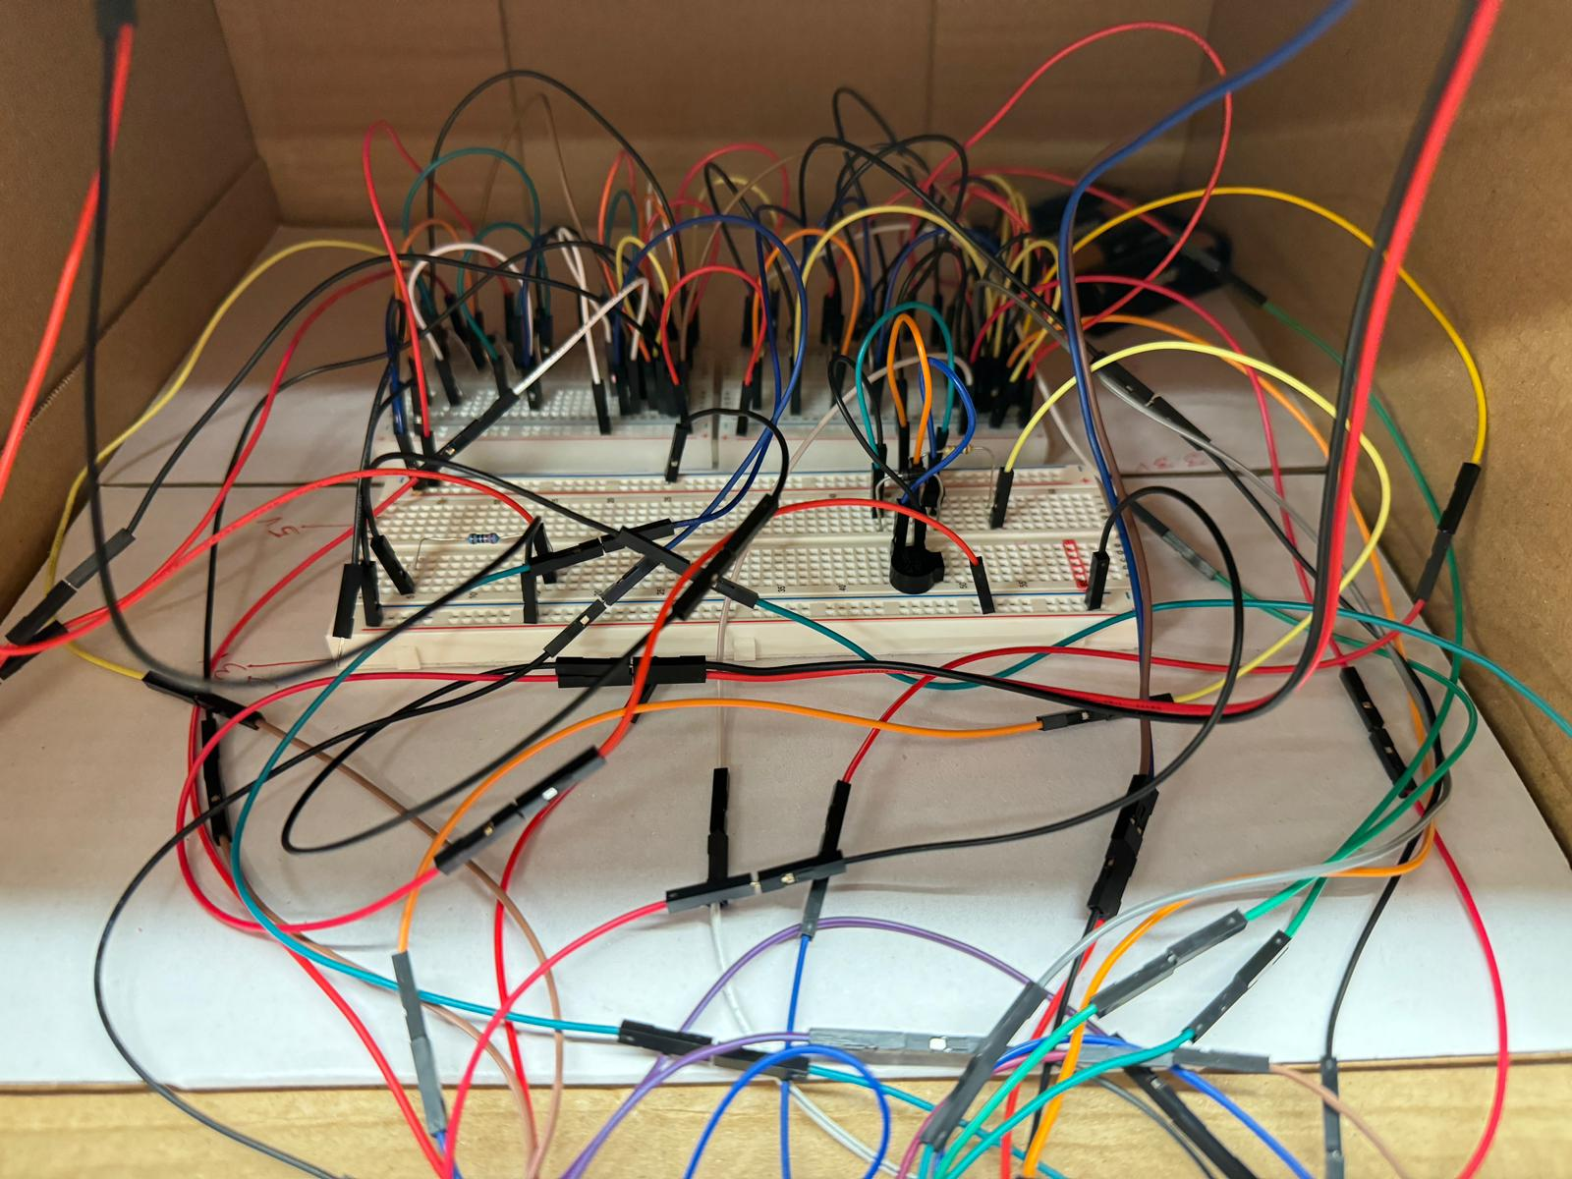
System photos
External System (User end)
Circuitry

Slide 8
Thank you!

